Slide 1
Determinantal point processes
Applications in quadrature

Slide 2

What is quadrature?
Rule for approximately integrating
Select points and construct weights according to this rule
E.g. Monte Carlo, Trapezium rule

Slide 3
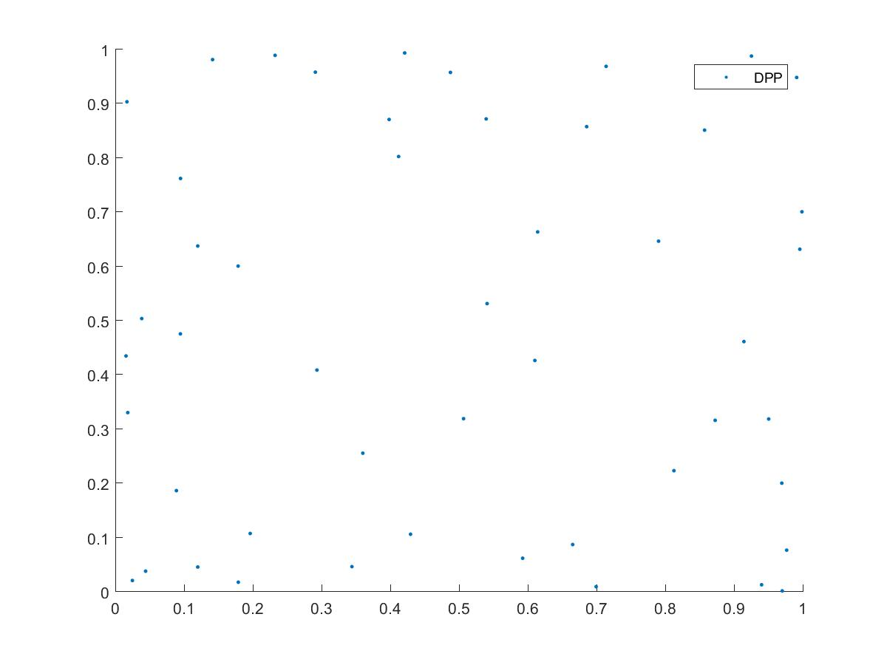
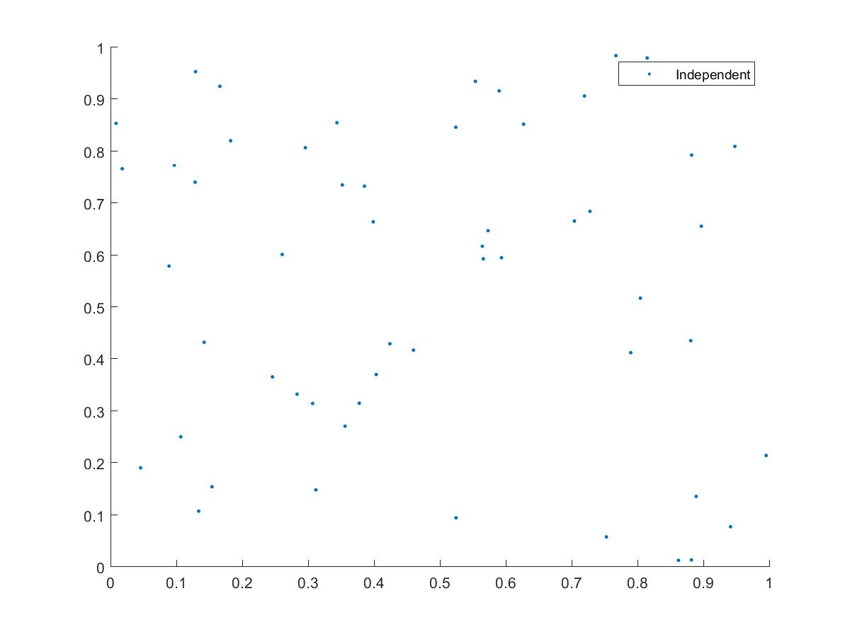
Why quadrature?
Draw points deterministically / from some distribution
Subsample according to DPP
Intuitively, spreads points out

Slide 4



Recap of Bach’s paper
Want to approximate
h lies in RKHS with kernel k(x,y)
Draw n points from importance sampling distribution q dρ
Estimate
Choose β to minimise error

Slide 5


Recap of Bach’s paper
where

Slide 6
Relation to Bach 2015
Bach uses importance sampling distribution for points / weights
Optimal distribution is the same as marginal distribution of a DPP
But also DPP has desirable quality of diversity
Independence

Slide 7
Bach’s quadrature drawing from ρ
Draw n points from ρ – so that q = 1
Compute exactly/approximate mean embedding
Compute weights
Perform quadrature

Slide 8
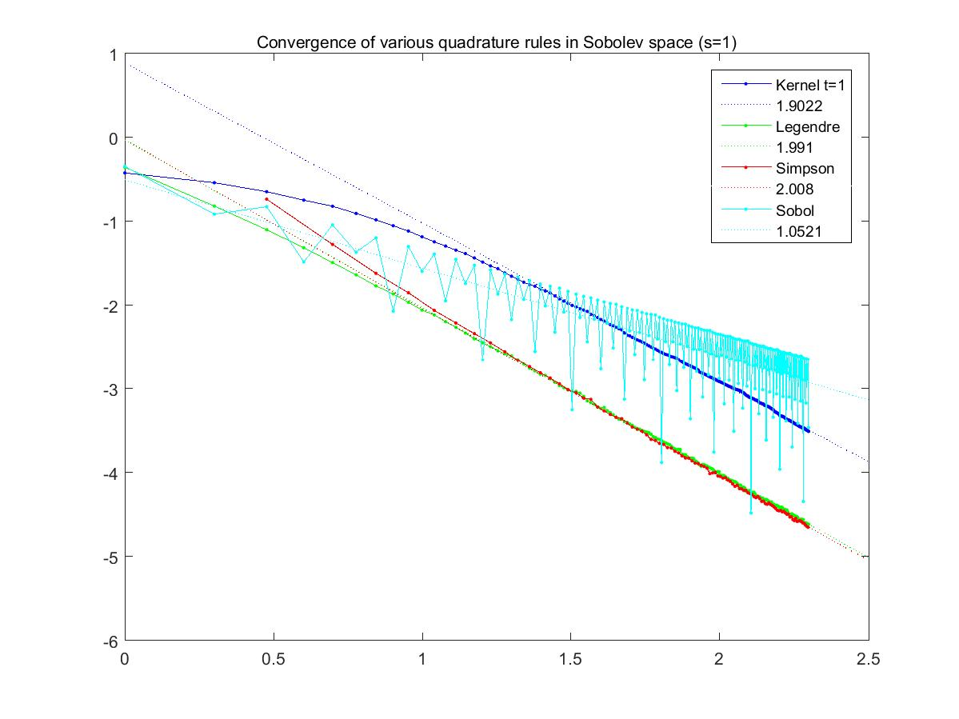
Sobolev space – comparison of various methods
Notes:
Kernel method more widely applicable – higher dimensions, non-differentiable/less smooth functions

Slide 9
Note: DPPs vs. n-DPPs
Draw from a DPP results in set of any size
To compare to methods where we choose exactly n points, we need to be able to draw sets of a specific size according to a DPP
Hence, n-DPPs: DPPs where we condition on size of set.
I have abused this notation – for the purpose of this presentation we will always use n-DPPs

Slide 10
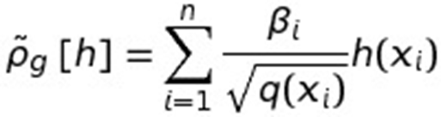
Quadrature with n-DPPs
Draw a large number of points from ρ
Subsample from an n-DPP with marginal kernel
Or with kernel K/λ ??? Then when λ=0?
Compute exactly/approximate mean embedding
Compute weights
With
Perform quadrature

Slide 11
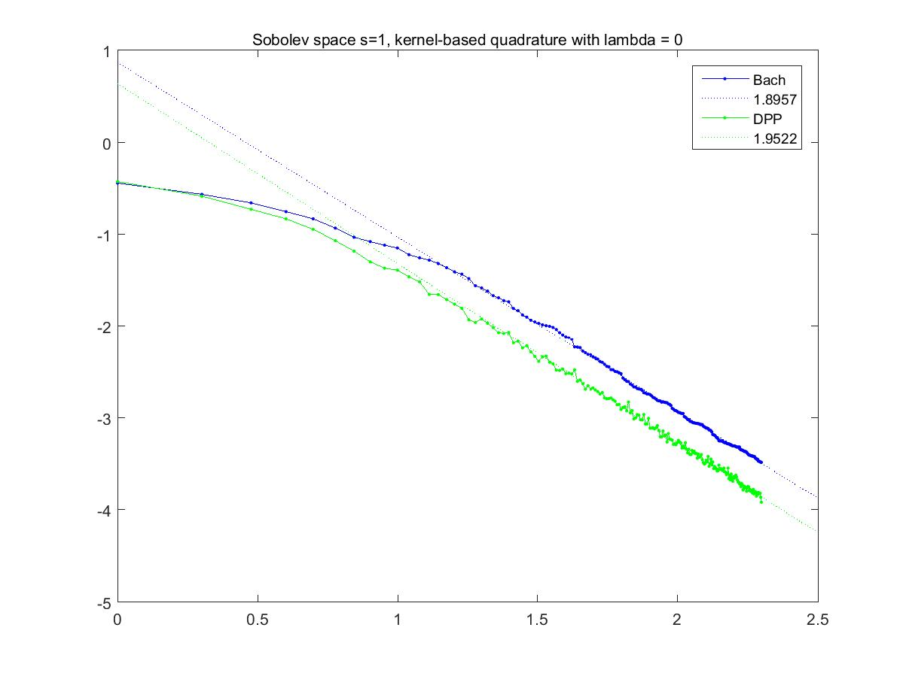
Sobolev space – Bach vs. DPP

Slide 12
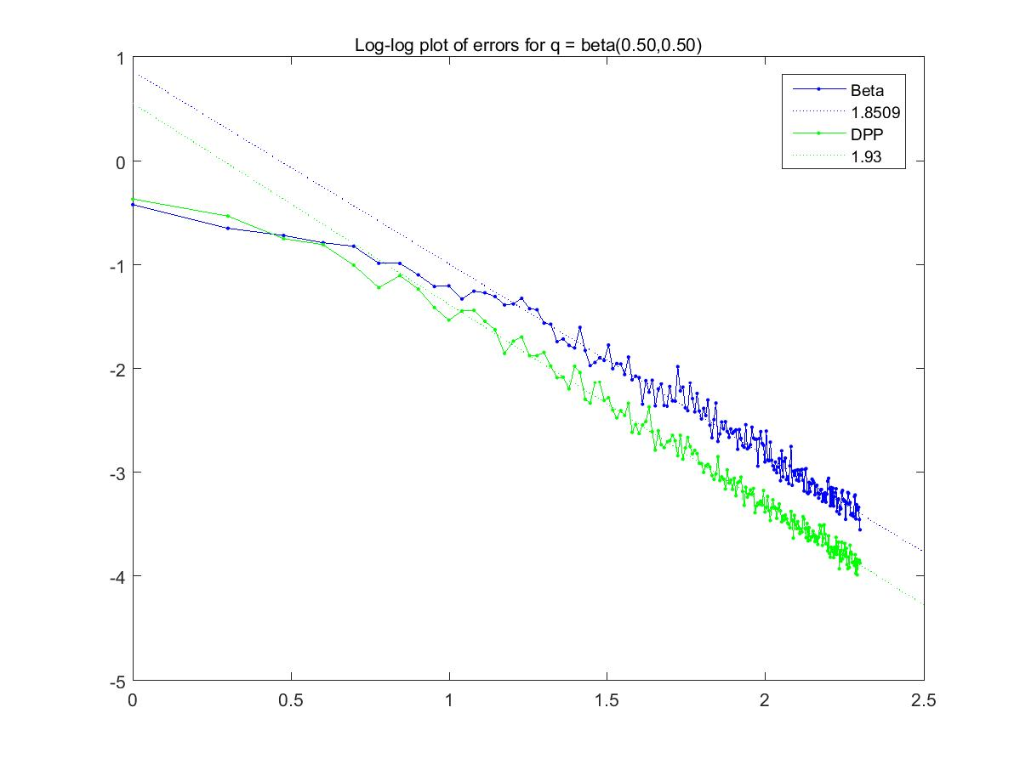
Sobolev space – Beta(0.5, 0.5) measure

Slide 13
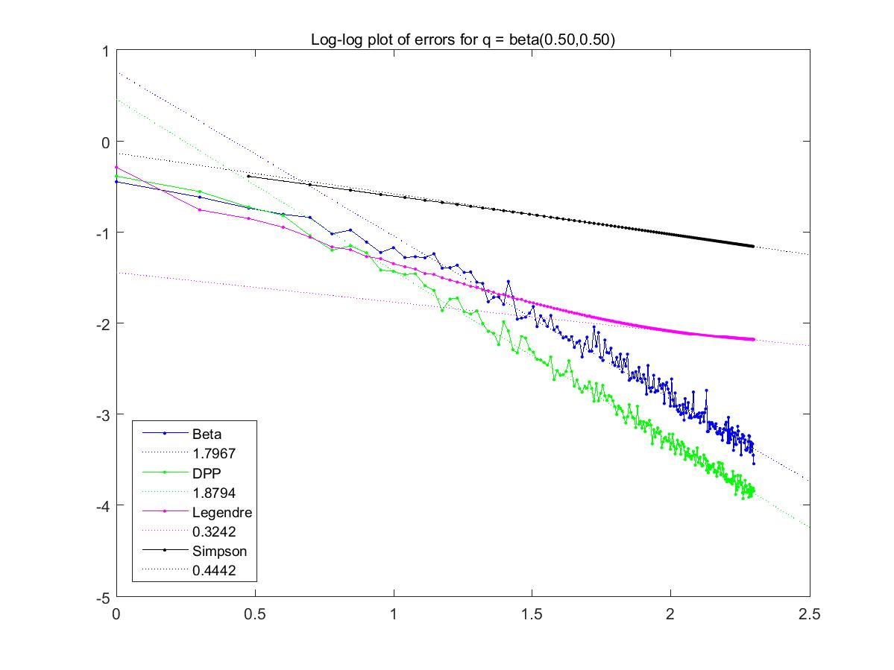
Sobolev space – Beta(0.5, 0.5) measure

Slide 14
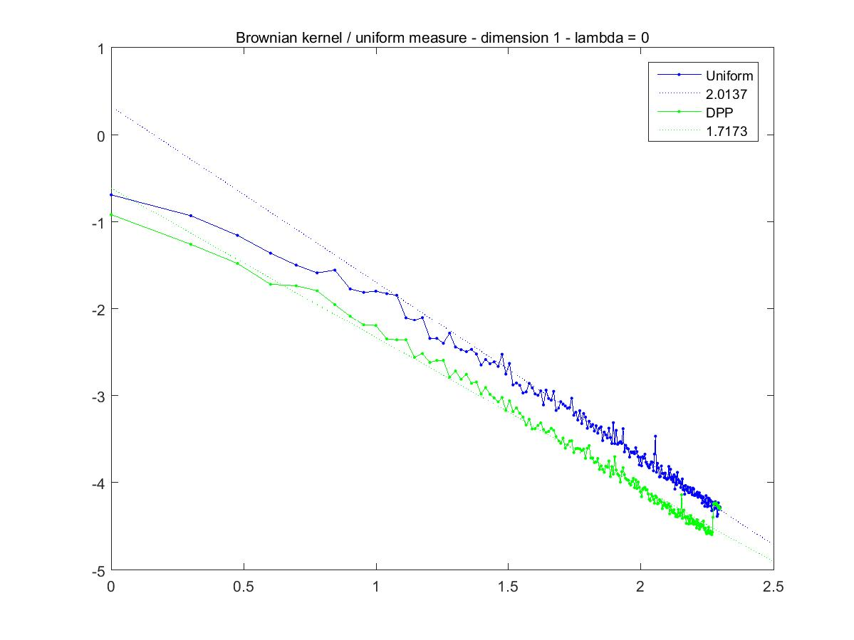
Uniform measure, Brownian covariance kernel
In 1 dimension, k(x,y) = min(x,y)

Slide 15
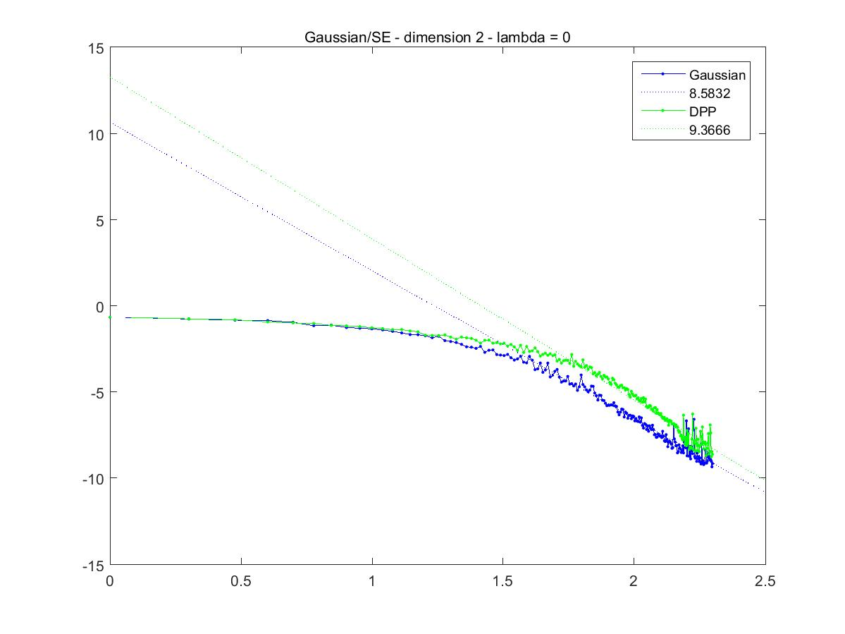
Gaussian measure, SE kernel

Slide 16
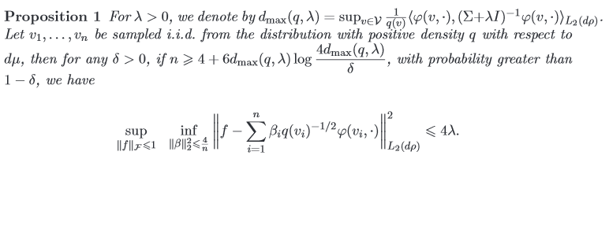
Introducing lambda
Corresponds to error level
Notes:
On notes add Lambda Proposition, weights and mercer’s thm stuff (wrt p).

Slide 17
Introducing lambda
Changes minimization problem, so changes weights
where

Slide 18


Introducing lambda
Bach’s optimal distribution and Mercer’s Theorem
Optimal distribution minimizes

Slide 19
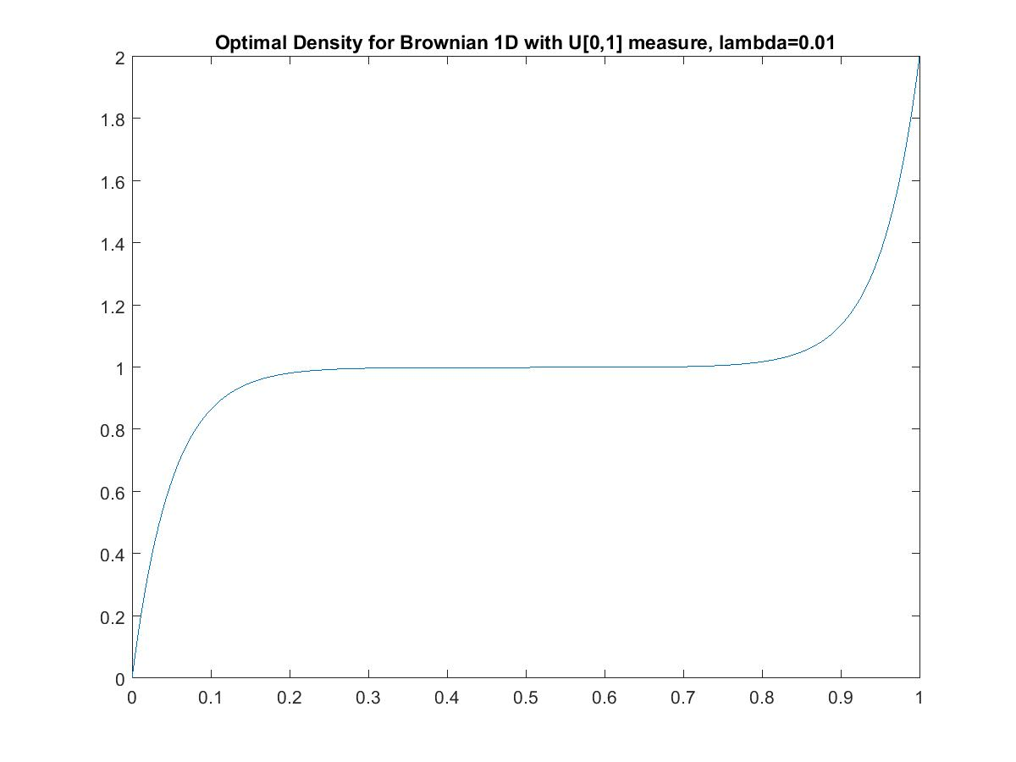
Optimal distributions

Slide 20
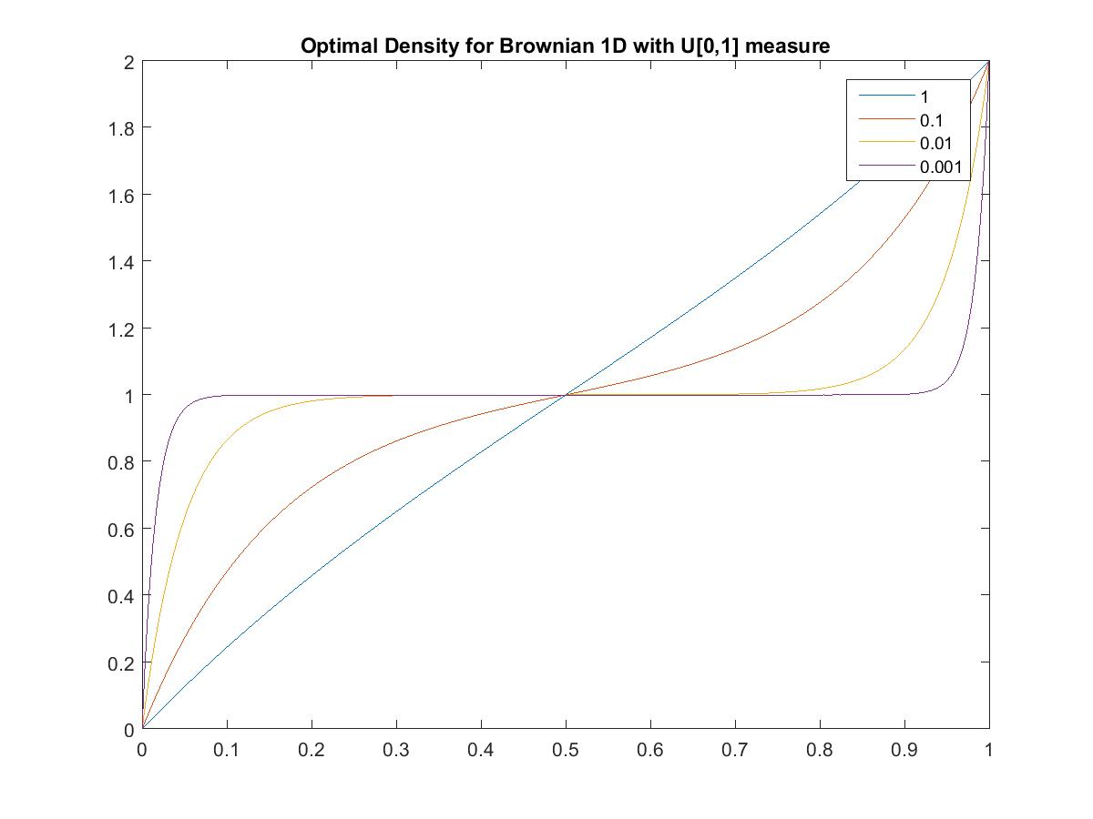
Optimal distributions

Slide 21
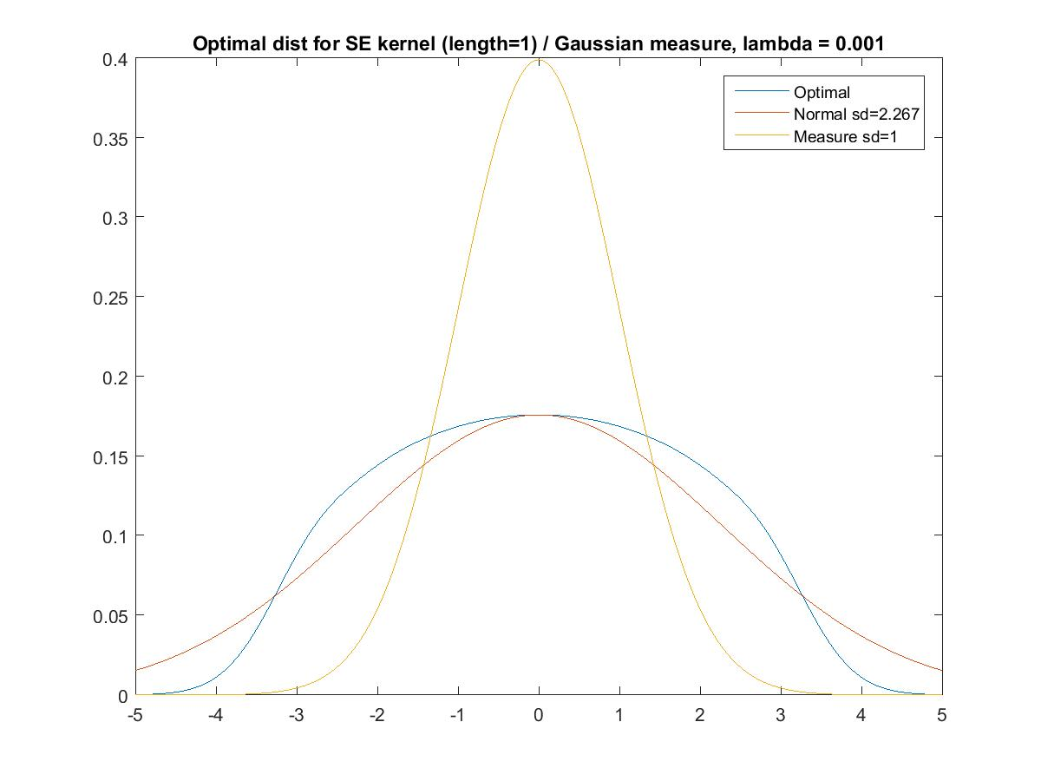
Optimal distributions

Slide 22
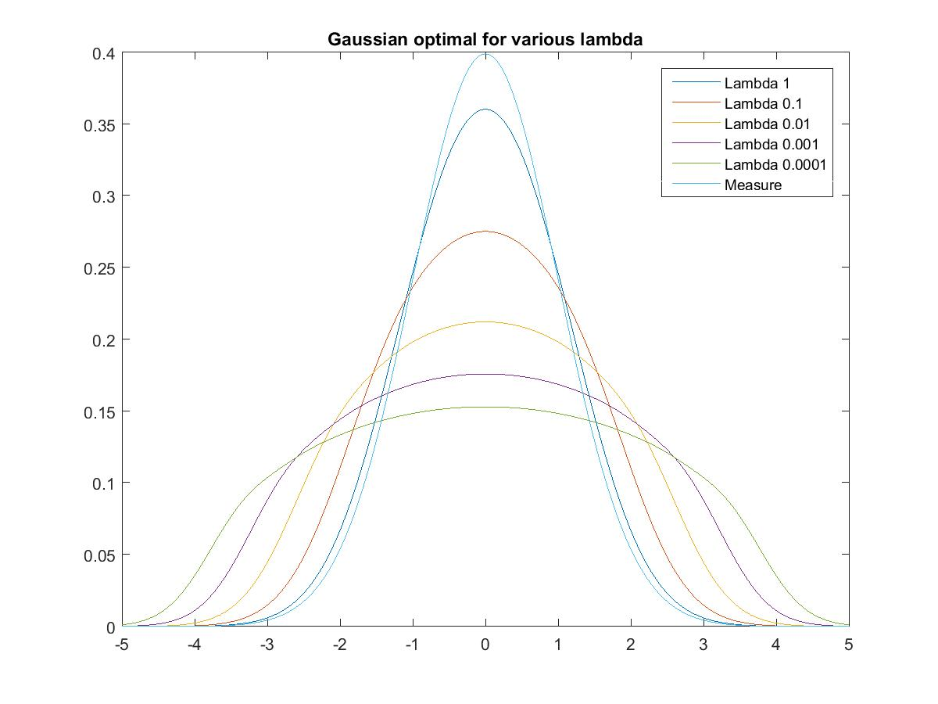
Optimal distributions

Slide 23
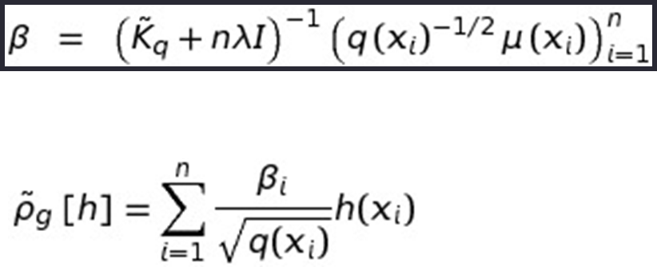
Quadrature with Bach’s optimal dist.
Draw n points from q dρ – where q is optimal distribution – depends on lambda
Compute exactly/approximate mean embedding
Compute weights
Perform quadrature

Slide 24
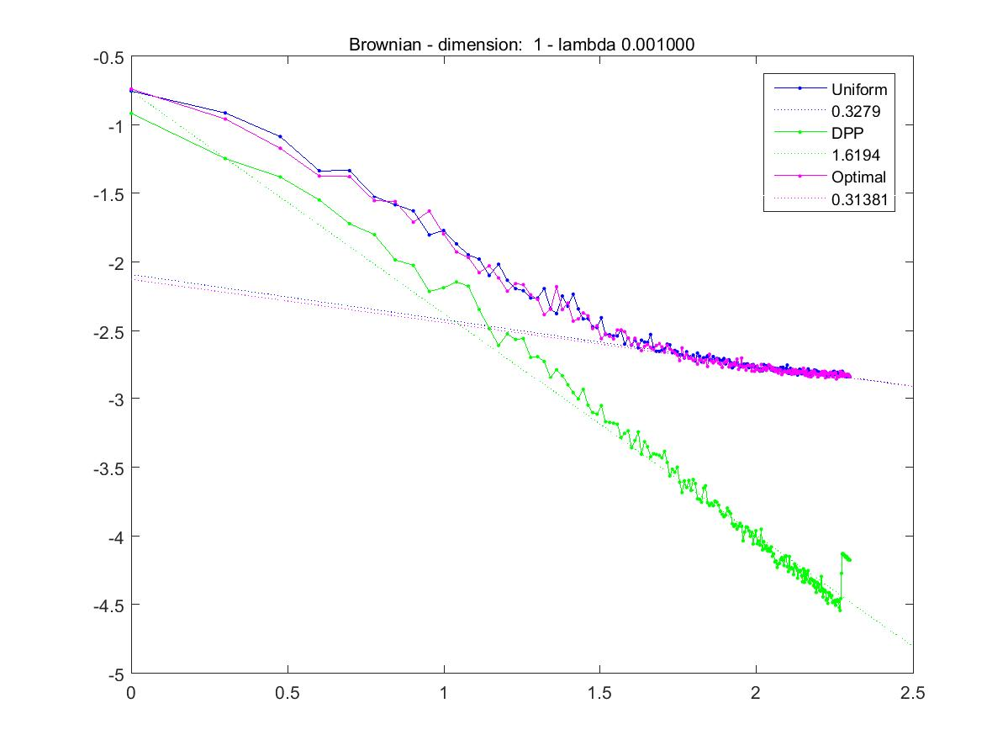
Bach vs. DPP – with lambda

Slide 25
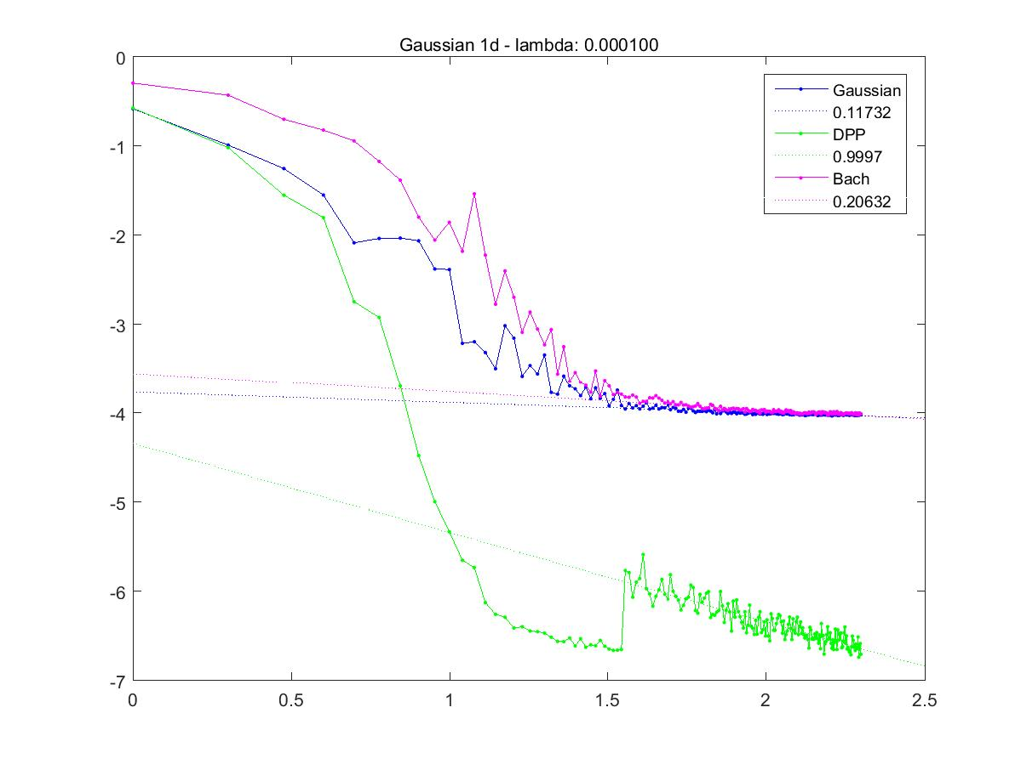
Bach vs. DPP – with lambda

Slide 26

Resampling to approximate Optimal
Often we won’t know optimal distribution exactly.
In optimal case, we had
This approximates operator:
This is also proportional to the marginals of a DPP with kernel K/λ

Slide 27

Quadrature with Resampling
Draw a large number of points from ρ
Subsample according to
Compute exactly/approximate mean embedding
Compute weights
Perform quadrature

Slide 28
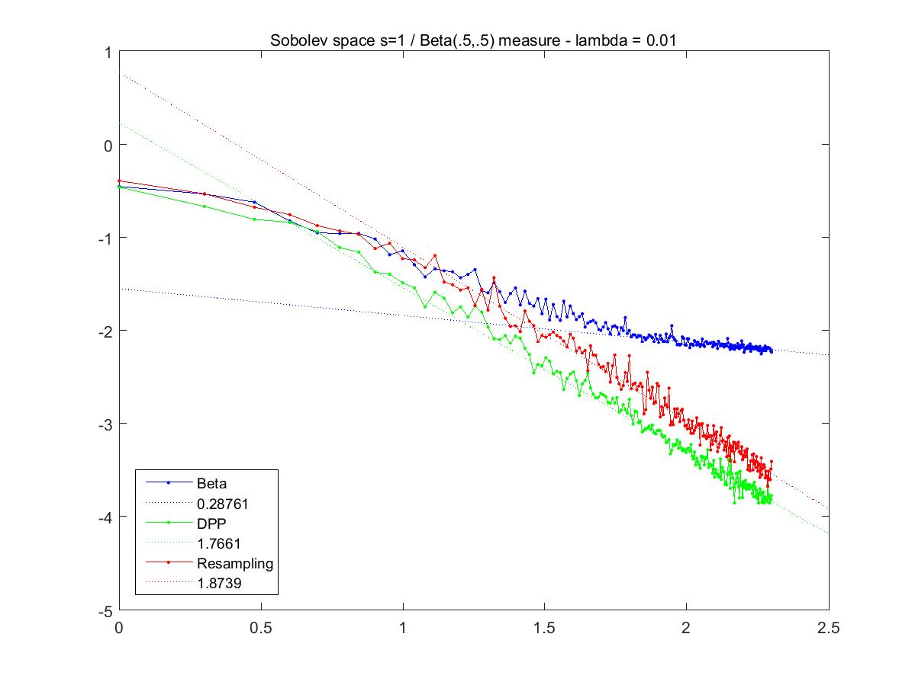
Resampling vs. DPP

Slide 29
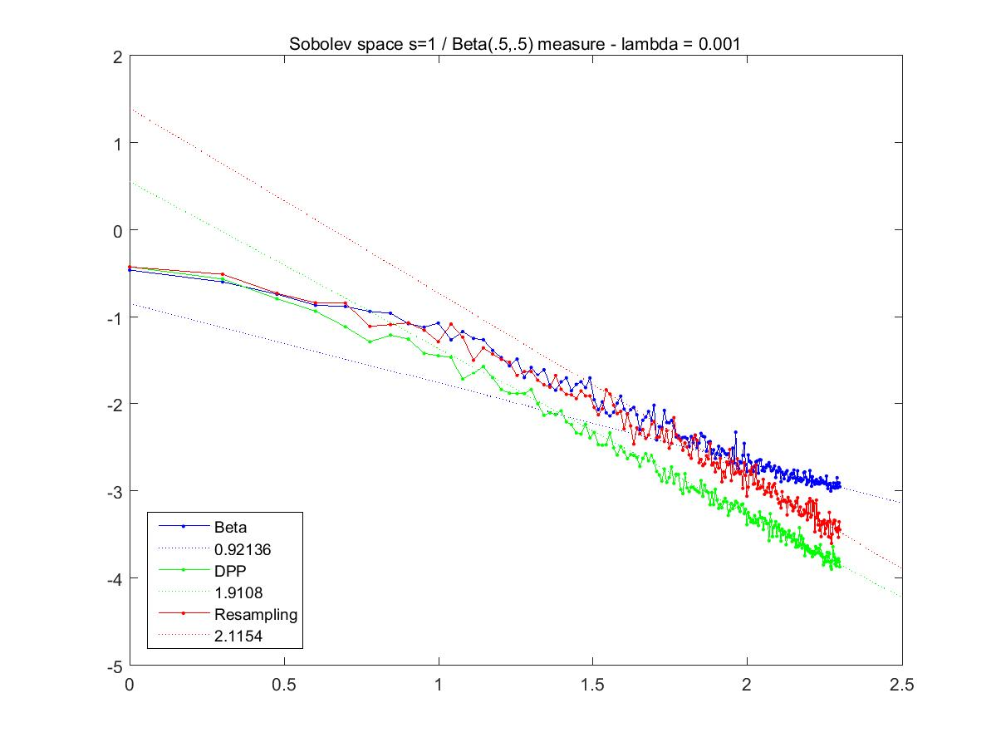
Resampling vs. DPP

Slide 30
Next steps
Computational matters
Theoretical guarantees
Continuous DPP
DPPs vs. n-DPPs

